Slide 1
Heroes of CSS

Slide 2
Warning!

Slide 3
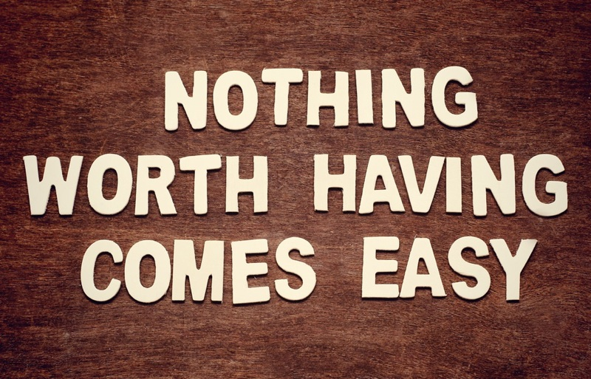
Brace Yourselves
Today is going to be a bit tough.
But trust us!
It will all look easy a few weeks from now.

Slide 4
Brace Yourselves
Don’t expect to understand EVERYTHING at once.
Today is all about getting immersed.

Slide 5
CSS Styling

Slide 6
Critical Question
What is “CSS?”

Slide 7


HTML / CSS Definitions (*yawn* unimportant)
HTML: Hypertext Markup Language – (Content)
CSS: Cascading Style Sheets – (Appearance)
HTML/CSS are the “languages of the web.” Together they define both the content and the aesthetics of a webpage – handling everything from the layouts, colors, fonts, and content placement. (JavaScript is the third – handling logic, animation, etc.)

Slide 8


HTML / CSS Analogy
HTML Alone
Like writing papers in “Notepad.”
Can only write unformatted text.
HTML / CSS
Like writing papers in Microsoft Word.
Can format text, page settings, alignment, etc. based on “highlighting” and menu options.

Slide 9

Basic HTML Page - Result

Slide 10

Enter CSS - Result

Slide 11

CSS Syntax
CSS works by hooking onto selectors added into HTML using classes and identifiers.
Classes use .classname, IDs use #idname, and elements use just their name.
Once hooked, we apply styles to those HTML elements using CSS.

Slide 12
CSS Example
In the below example the “Header” would be turned blue and MUCH larger because of the CSS.
We can incorporate an element’s class or ID to apply a CSS style to a particular part of the document.
Just remember to include the necessary symbol before the CSS: “.” for class, “#” for ID.
Example (HTML):
<p class=“bigBlue”>Header</p>
Example (CSS):
.bigBlue
{
font-size: 100px;
color: blue;
}

Slide 13
Key CSS Attributes
Font / Color:
color: Sets color of text.
font-size: Sets size of the font.
font-style: Sets italics.
font-weight: Sets bold.
Alignment / Spacing:
padding (top/right/bottom/left): Adds space between element and its own border.
margin (top/right/bottom/left): Adds space between element and surrounding elements.
float: Forces elements to the sides, centers, or tops.
Background:
background-color: sets background color.
background-image: sets background image.

Slide 14
Critical Question
How do we style HTML…
Elements?
Classes?
IDs?

Slide 15
Selectors
Element selector
Applies to all <p> elements
p {
background-color: blue;
}
Applies to all elements with class=“classItem"
.classItem {
background-color: orange;
}
Applies to all elements with id=“idItem"
#idItem {
background-color: green;
}
Element name
(p, a, div, span, etc)
Class Selector
Period (.) + variable name
(.myDiv, .phoneNumber, etc.)
ID Selector
Hash (#) + variable name
(#myDiv, #phoneNumber)

Slide 16
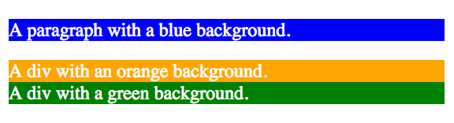
CSS Selectors
p {
background-color: blue;
}
.classItem {
background-color: orange;
}
#idItem {
background-color: green;
}
<p>
A paragraph with a blue background.
</p>
<div class=“classItem">
A div with an orange background.
</div>
<div id=“idItem">
A div with a green background.
</div>
+

Slide 17
Lingering Questions
Questions so far?

Slide 18
Relative File Paths

Slide 19
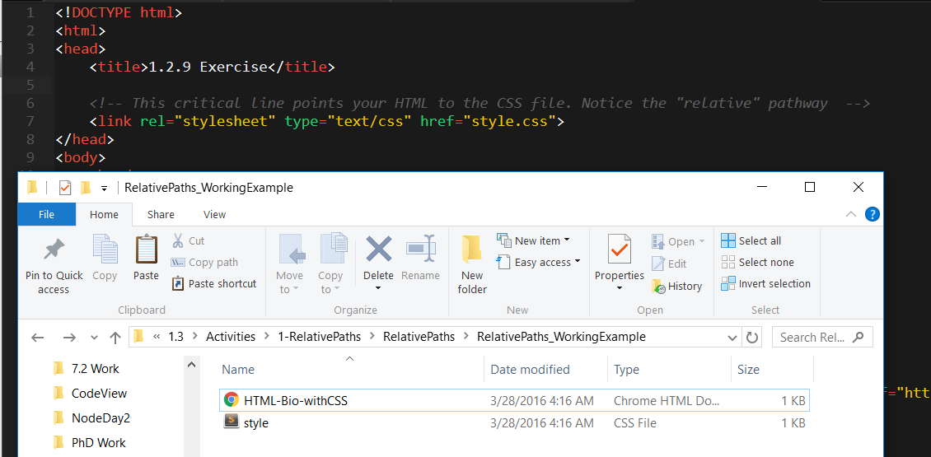
Relative File Paths
Relative file paths connect us with other files in our working directory. In this case, style.css is in the same folder as our html document.

Slide 20
Quick Demo
Instructor: Demo
(RelativePaths_DEMO | 1-RelativePaths)

Slide 21
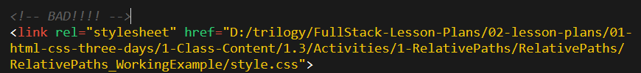

Absolutely No Absolute Paths
VERY VERY BAD
ALWAYS USE RELATIVE FILE PATHS.
If you deploy your sites without them, all of your links will fail.
The same will happen if you move your project from one folder to another.
Remember, there is no such thing as a “C:” drive on the internet.

Slide 22
> YOUR TURN!!
Activity: 1-RelativePaths| Suggested Time: 10 min
Assignment
1. Unzip the folder sent to you via Slack.
2. Edit the HTML files in all of the “RelativePaths” folders. You need to write relative paths that link the HTML documents with CSS stylesheets.
Tip: Check out the “RelativePaths_WorkingExample” folder.

Slide 23
Box Model

Slide 24
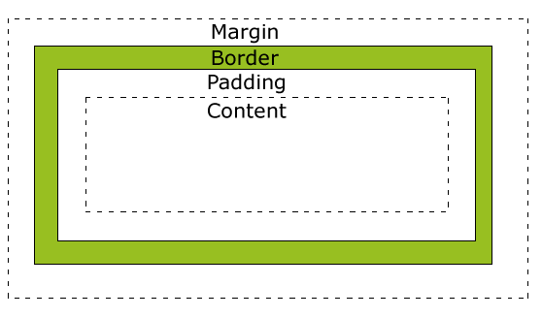
Boxes Upon Boxes
In CSS, every element rests within a series of boxes.
Each box has customizable space properties:
margin, border, and padding.
Typical spacing value: 20px 10px 10px 20px (top, right, bottom, left)

Slide 25
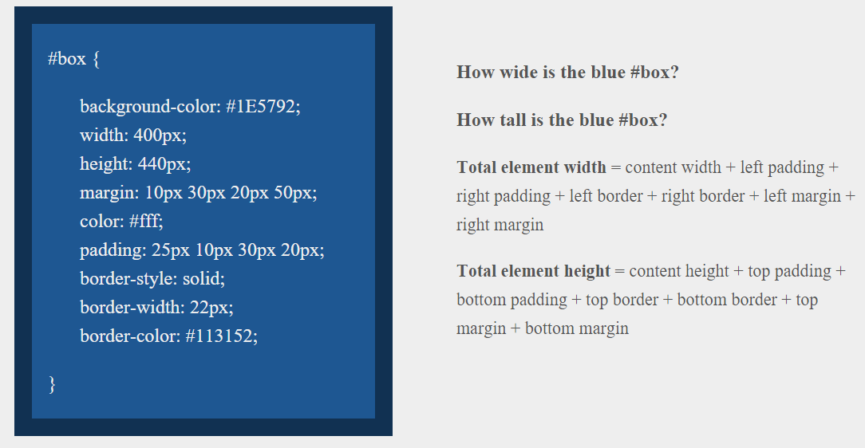
> YOUR TURN!!
Suggested Time: 10 min

Slide 26
> YOUR TURN!!
Answer
Width: 474 px (no margin), 554 px (with margin)
Height: 539 px (no margin), 569 px (with margin)

Slide 27
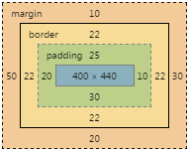
> YOUR TURN!!
Answer
Width: 474 px (no margin), 554 px (with margin)
Height: 539 px (no margin), 569 px (with margin)

Slide 28
We Be Floatin’

Slide 29

The Concept of “Flow”
By default, every HTML element displayed in the browser is governed by a concept called flow.
This means that HTML elements force their adjacent elements to flow around them.

Slide 30
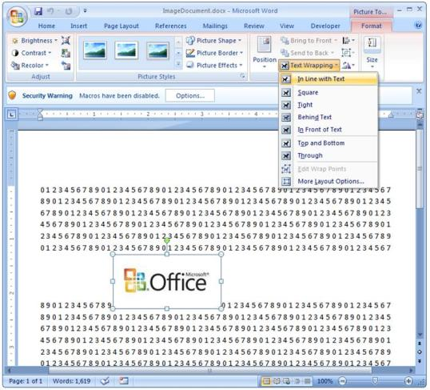
Flow Analogy to MS Word
This concept of “flow” is very similar to the wrap-text options you may be familiar with in Microsoft Word.
Just as in MS Word, you can have images in-line with text, on-top of text, etc.

Slide 31
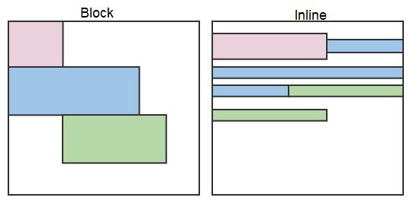
Block Elements
By default, web clients render many HTML elements as block elements. Paragraphs, headers, divs and more receive this treatment.
A block element will take up an entire line of space—unless you intervene with CSS properties.

Slide 32
Block Elements vs. Inline Elements
Now contrast the block elements with inline elements.
By using float CSS properties, we can command our website to display multiple HTML elements adjacently.

Slide 33
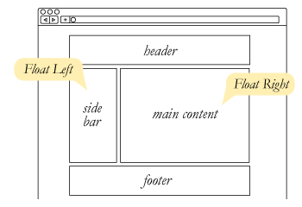
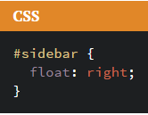
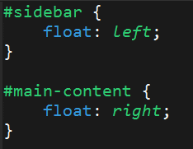
Floating
To transform these block elements into inline elements, we use a CSS property called float.
Floats are necessary for building web layouts.

Slide 34
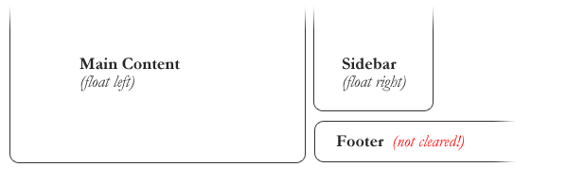
Clearing the Float
Floats often get in the way of our layouts.
Sometimes we don’t want to give each element the “inline” treatment.

Slide 35
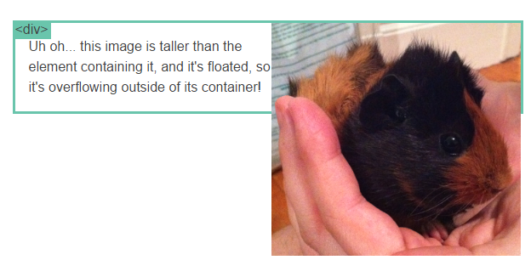
Clearfix Hack
Sometimes when elements don’t match up in size, we get situations like the above…

Slide 36
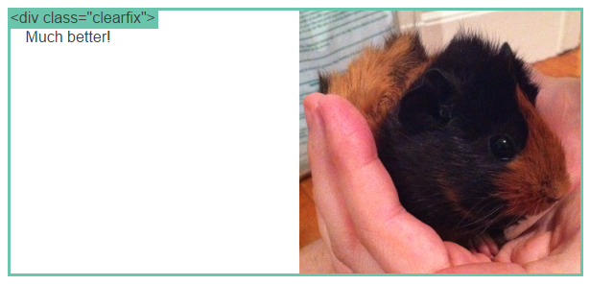
Clearfix Hack
We can get around this by using “the clearfix hack.”

Slide 37
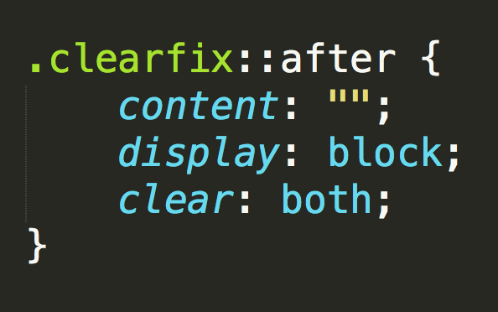
Clearfix Hack
::after is what we call a pseudo-element. We use it to style specific parts of an element.
This will add an HTML element, hidden from view, after the content of the “.clearfix” element. This clears the float.

Slide 38

Quick Demo!

Slide 39
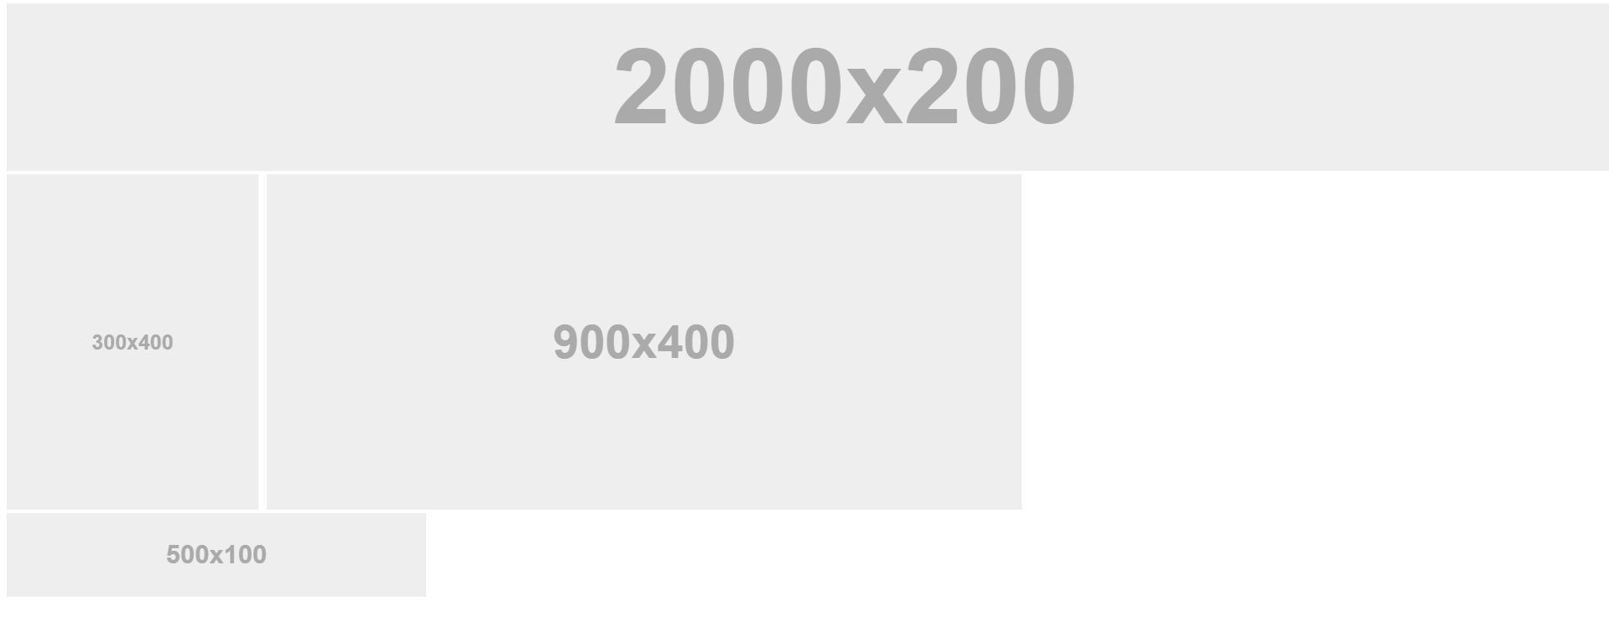
Quick Demo!

Slide 40
Quick Demo
Instructor: Demo
(2-FloatExamples)

Slide 41

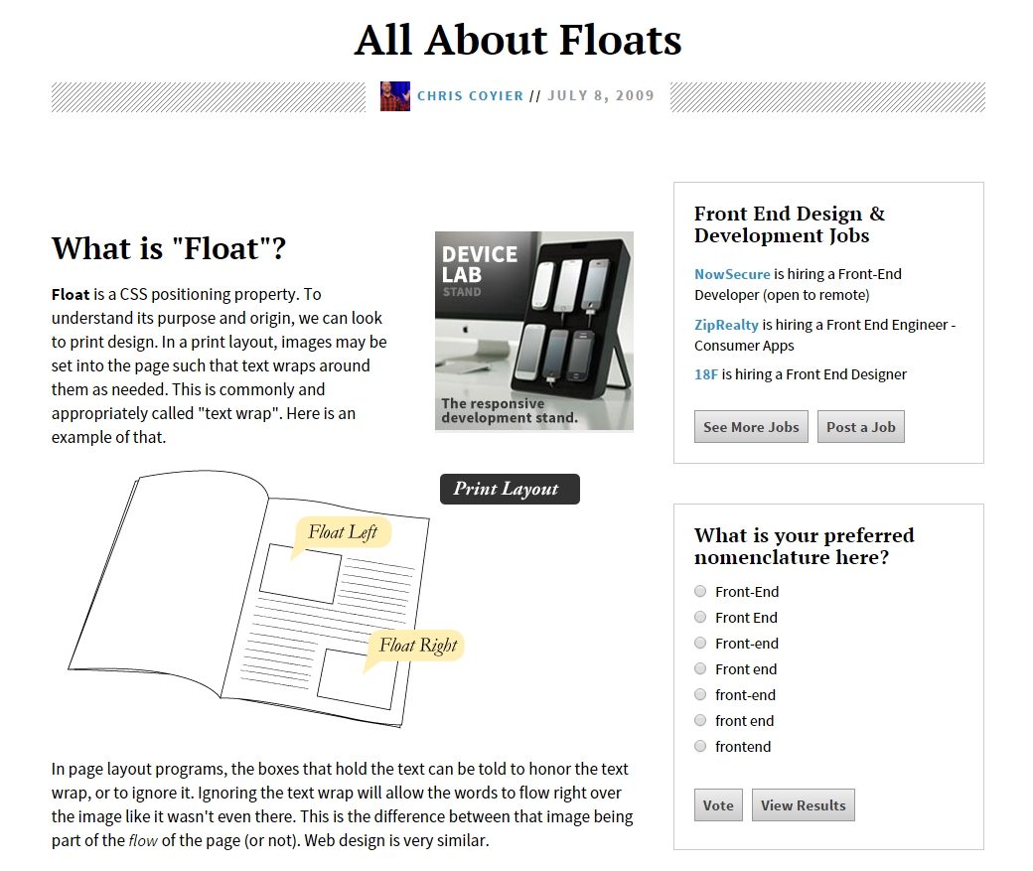
Fantastic Guide on Floats ****
To all serious front-end developers (this is a necessary read): https://css-tricks.com/all-about-floats/

Slide 42
> YOUR TURN!!
Activity: 3-FloatLayout-Activity | Suggested Time: 30 min
Assignment
In this activity, you’ll flex your newfound floating skills by creating a conceptual layout. Eyeball the design to your best ability.
Check your Slack for more instructions.

Slide 43
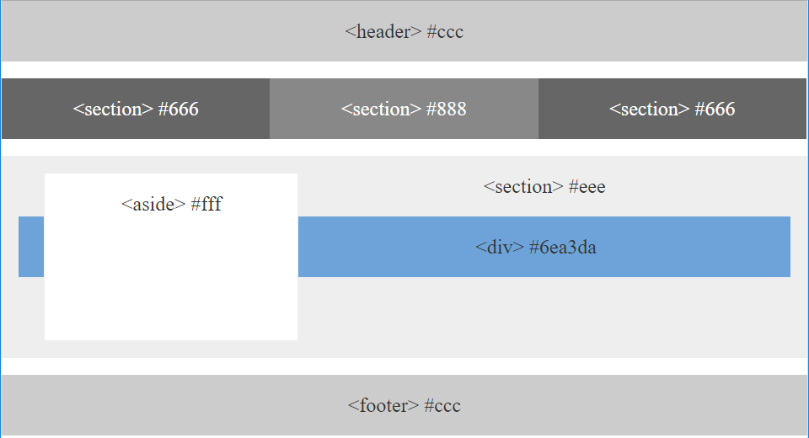
> YOUR TURN!!

Slide 44

Good work!
Your brain may rest now…

Slide 45
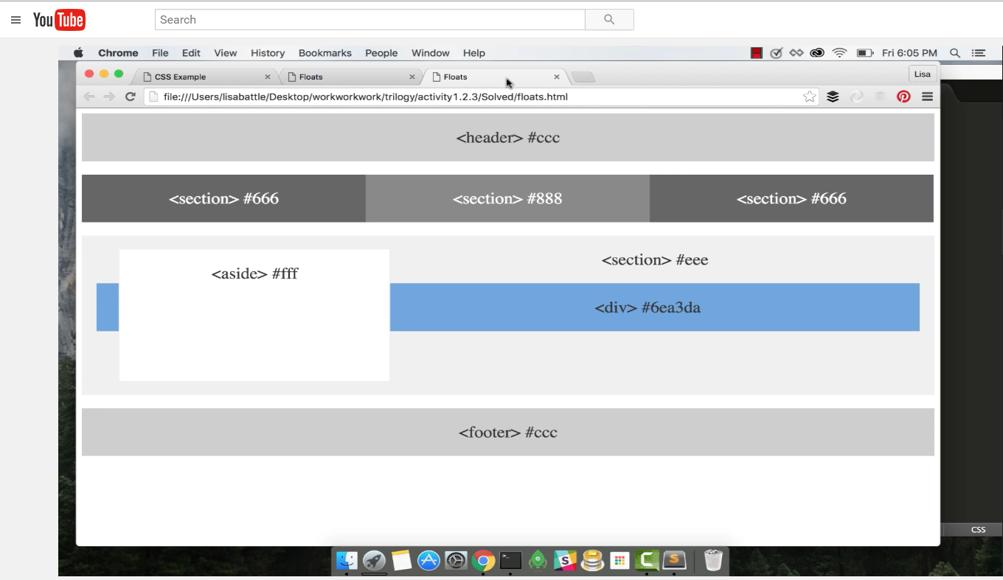
Video Walkthrough! (Highly, HIGHLY Recommend!!!)
Video Link: https://youtu.be/0lpxKw6E90Y

Slide 46
BREAK!

Slide 47
CSS Positioning

Slide 48
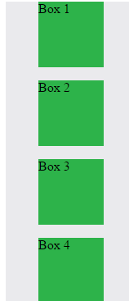
Position: Static (Default)
Four boxes placed statically (default)

Slide 49
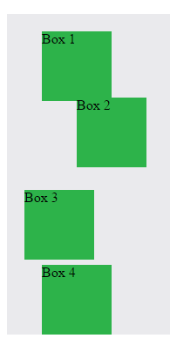

Position: Relative
Switching the boxes to relative will nudge the boxes in relation to their “original” location.

Slide 50
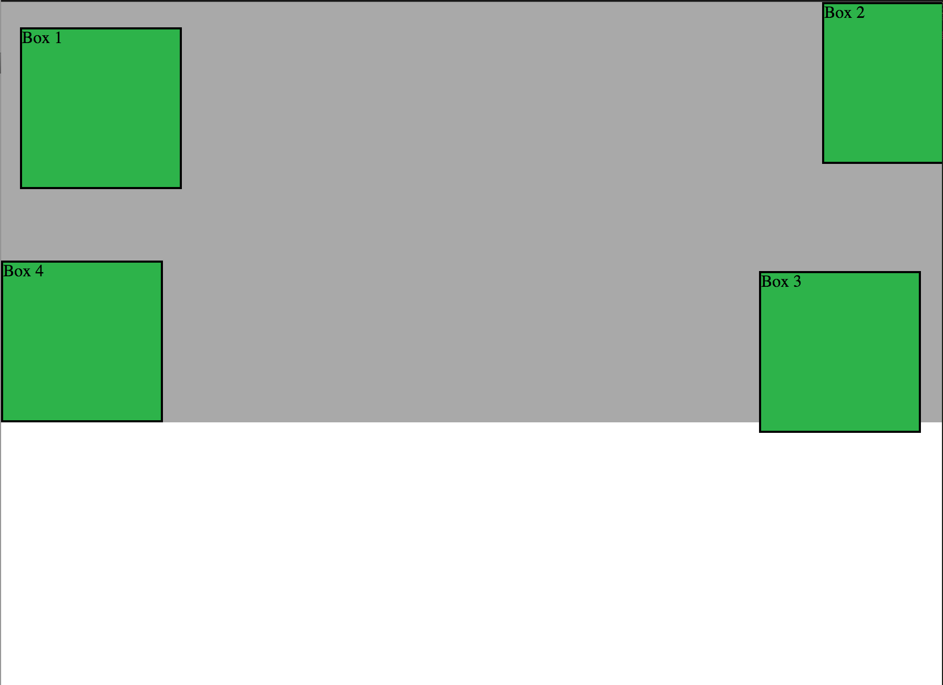
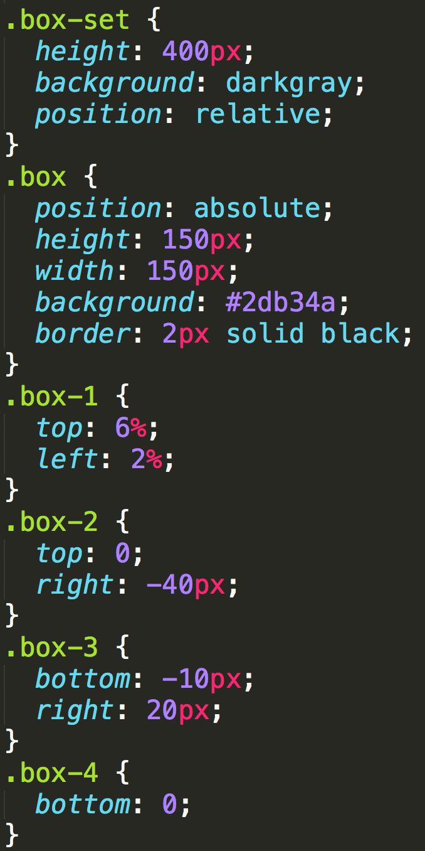
Position: Absolute
Positioned relative to nearest positioned ancestor
Notes:
An element that is positioned absolutely is taken out of the flow and thus takes up no space when placing other elements.
The absolutely positioned element is positioned relative to nearest positioned ancestor (non-static).
If a positioned ancestor doesn't exist, the initial container (body) is used.

Slide 51
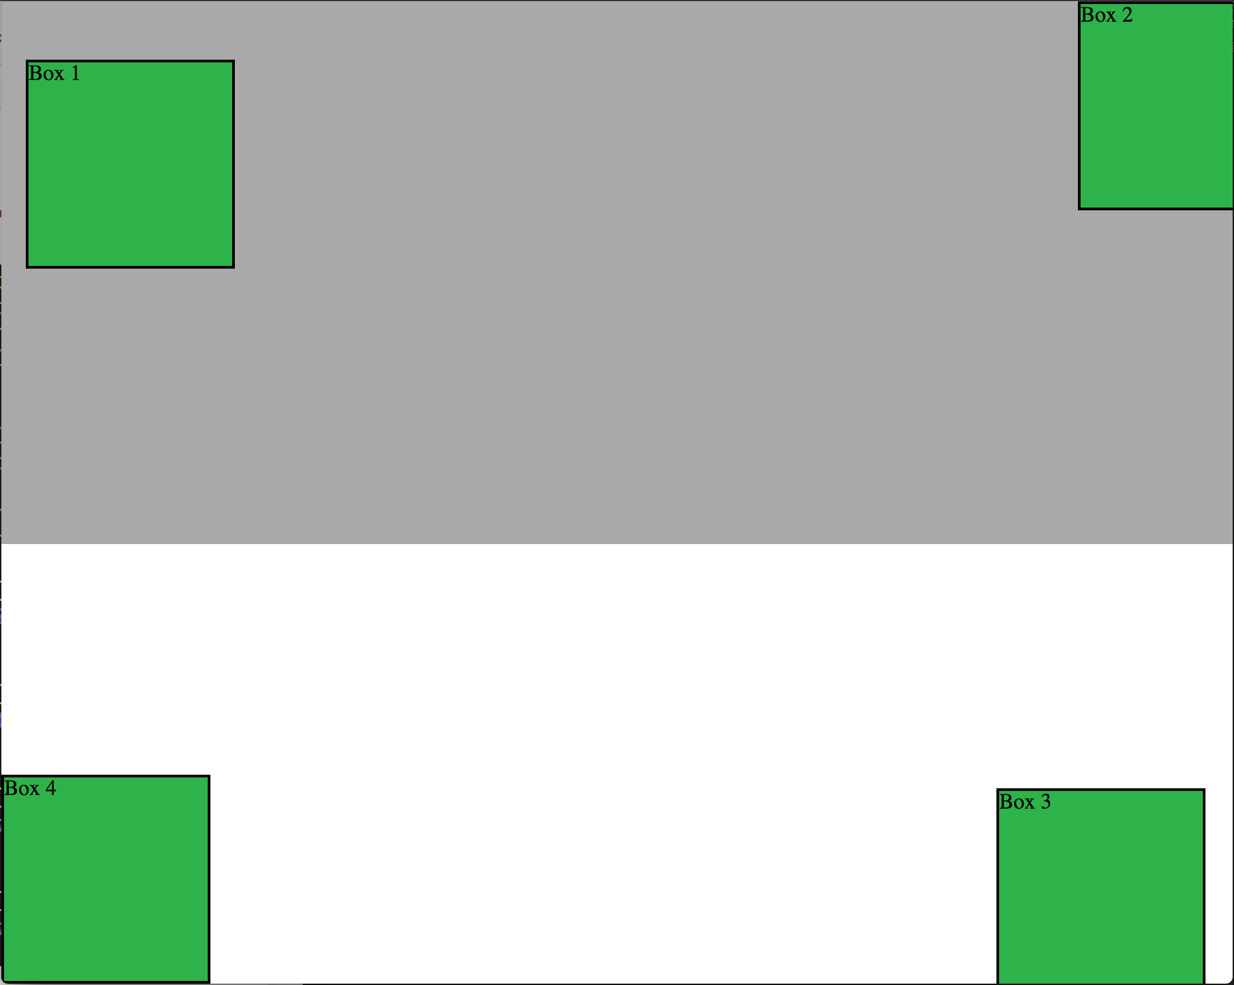
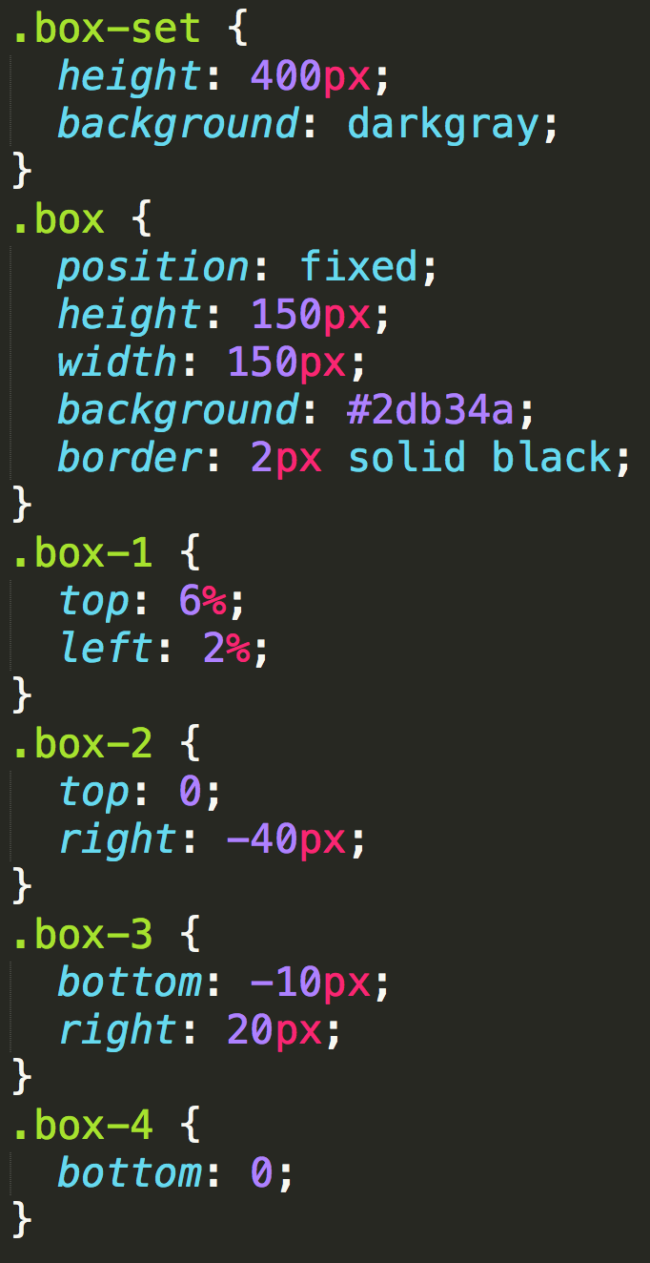
Position: Fixed
Position with exact coordinates to the browser window

Slide 52
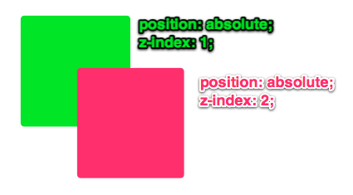
Layering with Z-Index
Z-Index allows you to layer elements on top of each other when they’re positioned.
Notes:
The elements must be positioned (any position other than static)

Slide 53
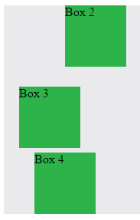
Hiding Things
“Display: none” allows us to hide elements from view.
This will become useful in later sections, when we’ll be hiding and revealing specific HTML elements of our choice.

Slide 54
Quick Demo
Instructor: Demo
(5-CSS_PositionedLayout)

Slide 55
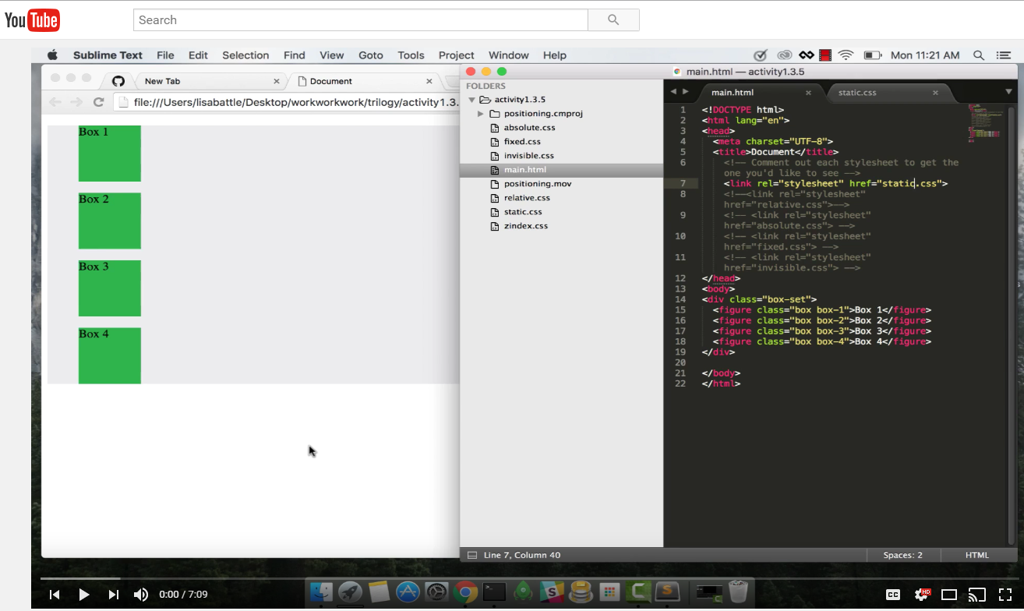
Video Walkthrough!
Video Link: https://youtu.be/sHfJn0jqBro

Slide 56
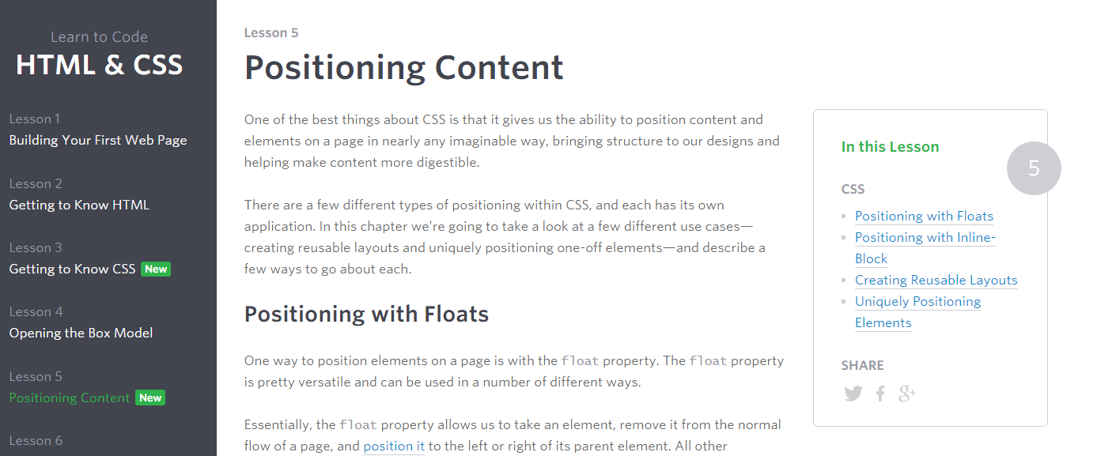
Great Resource
Another great read for front-end developers: http://learn.shayhowe.com/html-css/positioning-content/

Slide 57
> YOUR TURN!!
6-CSS_Positioned_Activity | Suggested Time: 30 min
Assignment
In this activity, you’ll flex your newfound positioning skills by creating another conceptual layout. Eyeball the design to your best ability.
Check your Slack for additional instructions.

Slide 58

> YOUR TURN!!

Slide 59
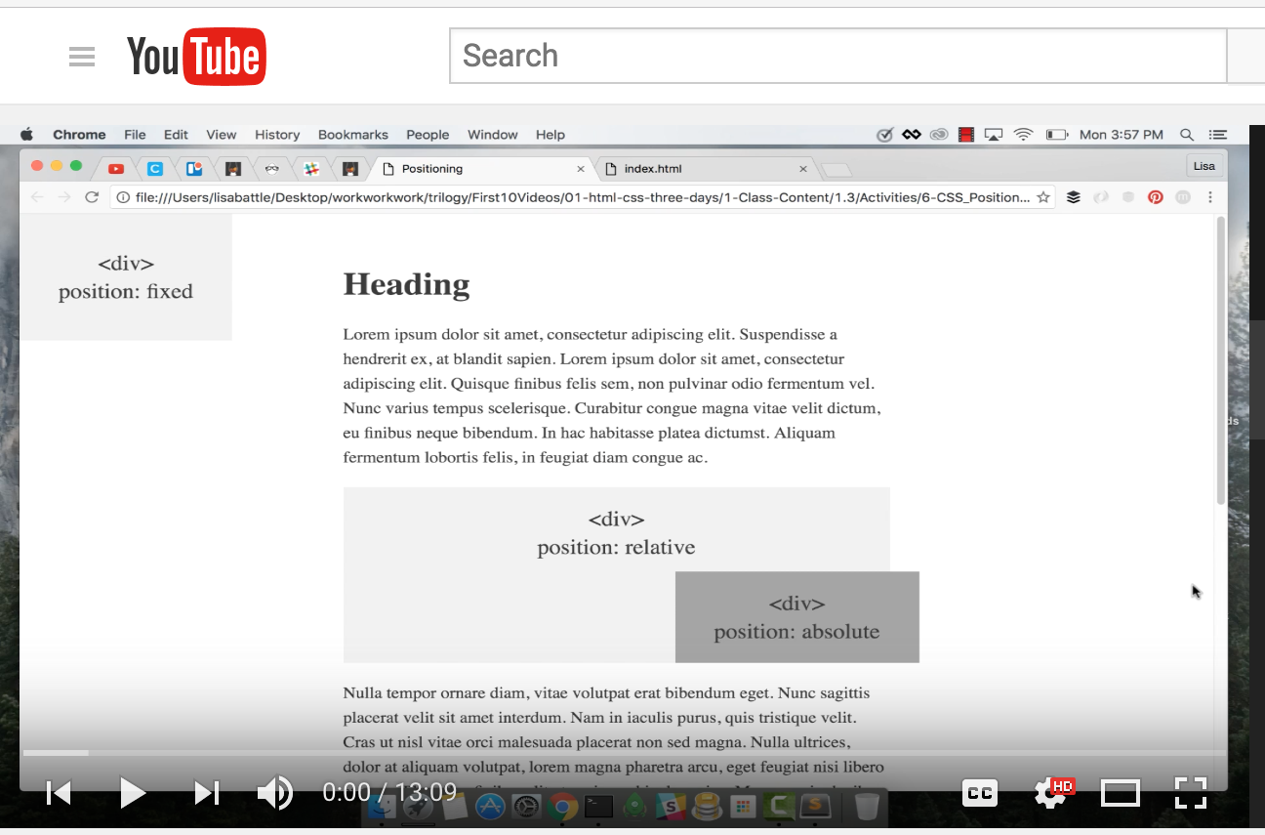
Video Walkthrough!
Video Link: https://youtu.be/yWXgnQaWSW0

Slide 60
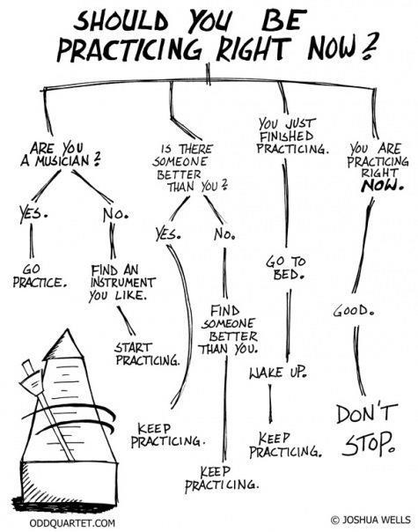
Advice
Re-do this at home. We designed this exercise
to firm up your HTML/CSS skills.
REMEMBER:
The best way to learn
web development
is to PRACTICE!

Slide 61
Chrome Inspector

Slide 62
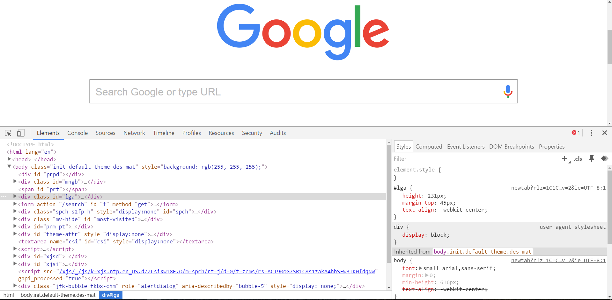
Chrome Inspector is Your Friend
To access chrome inspector, right click on a page. Then hit “Inspect.”
It will allow you to inspect the HTML, CSS and more!

Slide 63

Chrome Inspector is Your Friend
You can even edit the HTML/CSS of a webpage and instantly view your changes in the browser!
This works on any website, whether yours or not.

Slide 64
Next Class!
We’ll be coming back to this
in our next class.

Slide 65
Recap + Reassurances

Slide 66


Slide 67
Questions?

Slide 68
EXTRA MATERIAL

Slide 69
> YOUR TURN!!
Assignment
Take a website you commonly visit (Amazon, Google, Huff Po, etc.) and heavily modify it with Google Developer Tools.
You have 15 minutes to test Chrome Inspector. Try modifying:
Content (change words).
Colors.
Spacing.
Any other CSS style rules.
When you’re done, send a screenshot to your class’s Slack.

Slide 70
CSS Resets

Slide 71

Loading Multiple CSS Files ***(Very Important!!!)***
We can link our documents to more than one stylesheet at a time—one of the most powerful features of CSS/HTML.
By tapping into different stylesheets simultaneously, we can create complex layouts with plenty of design rules.
Just remember: the loading order matters!!!

Slide 72
What Browser?
By a show of hands…
Which browser do you use?

Slide 73

Battle of the Browsers
Under the hood, web browsers often render webpages differently than their competition.
These disparities could mean HTML/CSS displaying differently in each web client.
Because of these potential divergences, web developers need to make their websites cross-browser compatible.

Slide 74

Reset.css (or Normalize.css)
Reset.css will “reset” all browser-specific CSS. This means your site will appear the same in all browsers.
However, you will have to re-style everything yourself.

Slide 75
Why CSS Resets Matter
It’s important for creating browser-compatible websites.
It’s an example of using someone else’s CSS in your website!!!
It’s a common Front-End Developer Interview question.

Slide 76
> YOUR TURN!!
Assignment
Follow the instructions given via Slack to incorporate a reset.css file in a basic HTML file.
Note the impact of the reset file makes after you include it.

